Slide 1
Kstreams of Kafka
Introducing Kafka
Introducing KStreams

Slide 2
Intro to kafka
PUBLISH & SUBSCRIBE: Read and write streams of data like a messaging system.
PROCESS: Write scalable stream processing applications that react to events in real-time.
STORE: Store streams of data safely in a distributed, replicated, fault-tolerant cluster.
Recapitulation:
Kafka® is used for building real-time data pipelines and streaming apps. It is horizontally scalable, fault-tolerant, wicked fast, and runs in production in thousands of companies.

Slide 3
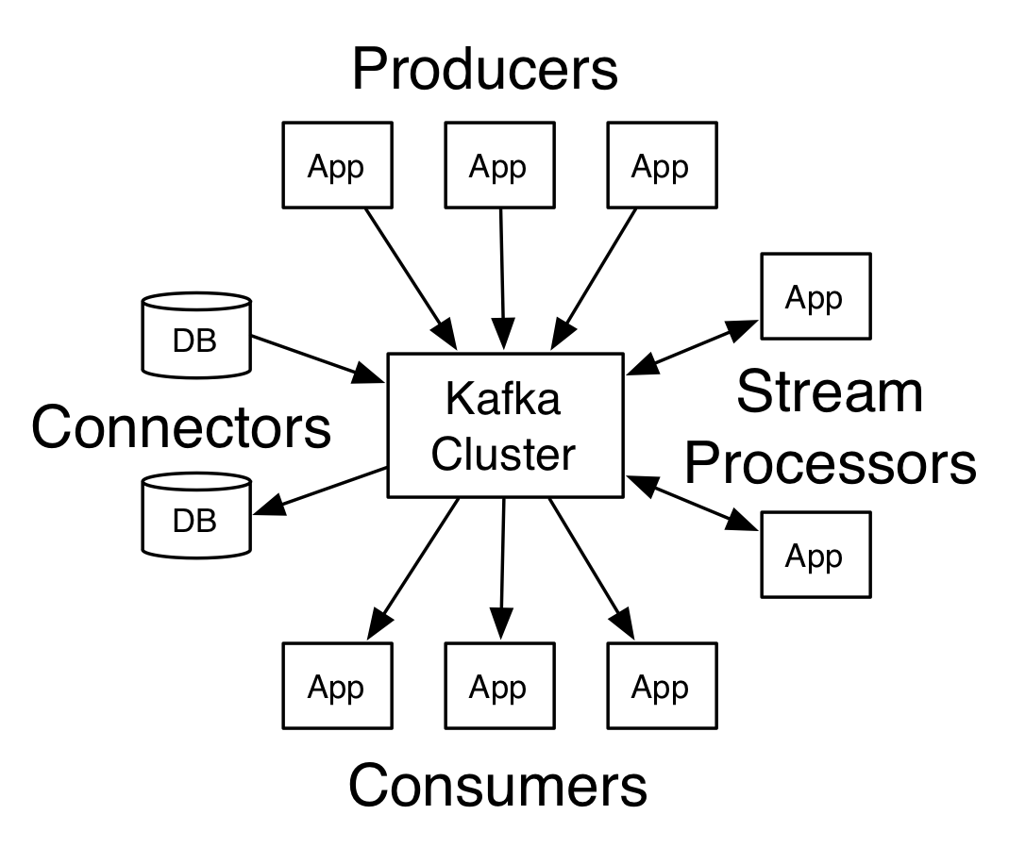
Intro to kstreams
f
Recap:
Kafka Streams is a client library for processing and analyzing data stored in Kafka. It builds upon important stream processing concepts such as properly distinguishing between event time and processing time, windowing support, and simple yet efficient management and real-time querying of application state.

